Slide 1

Development of a model order reduction library for an Android-based FEM app
Cakal, Karakaya, Meßmer
Technische Universität München
Software Lab
Department of Civil, Geo and Engineering
Munich, 02. August 2018

Slide 2
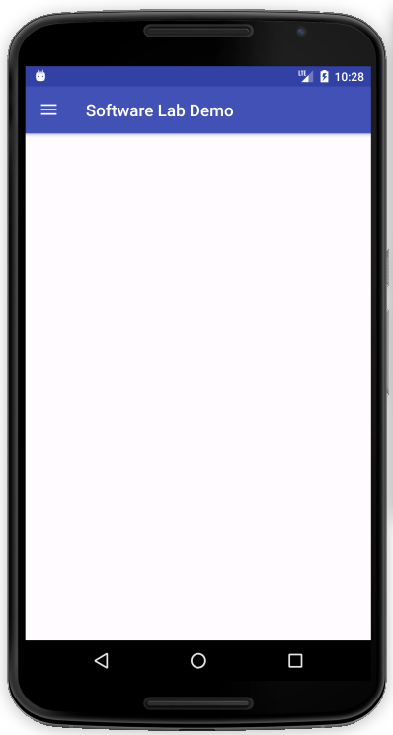


Why using FEM on a Smartphone?
Two Major Fields of Application
Teaching Tool
Helps students to understand the workflow of FEM
Solutions can be obtained easily
Portable Computational Support
Analyse structure on site
Provides first rough estimation of the problem
www.Colourbox.de
www.Colourbox.de

Slide 3
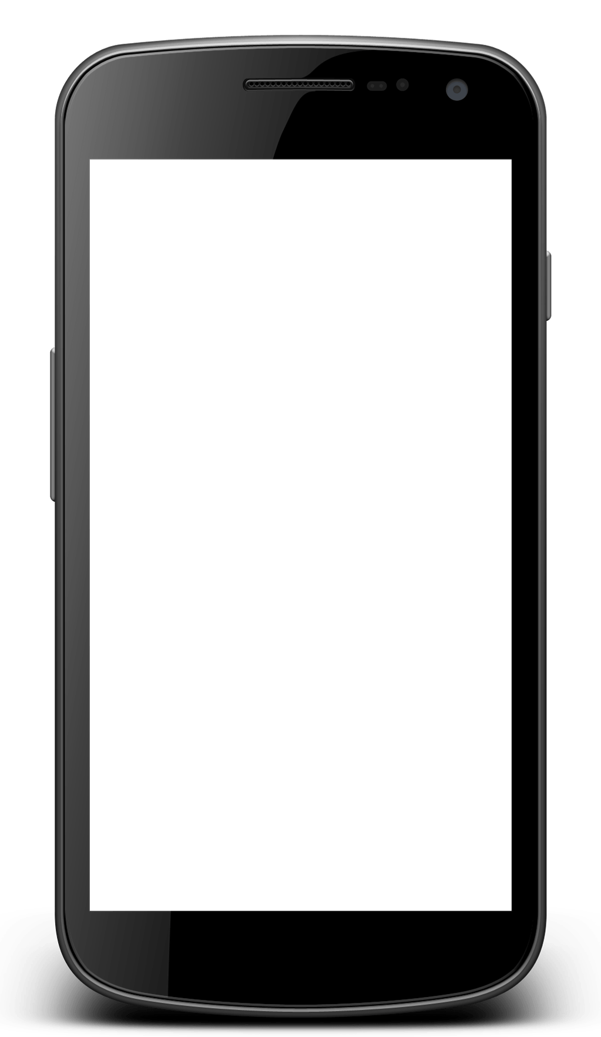
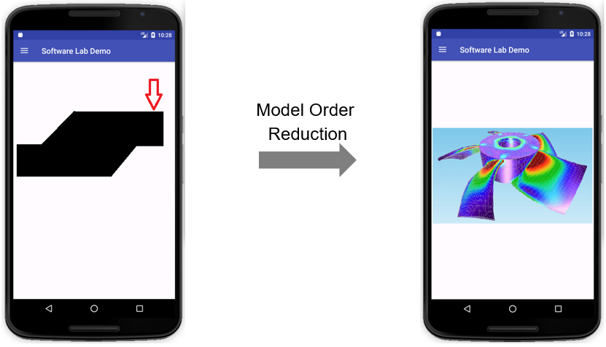
Where did we start?
We started from the very beginning…
Our Task is…
Create a 2D - FEM framework that runs on a wide range of Android devices
Guide user intuitively from Geometry Creation to Post-Processing
Provide a Model Order Reduction Method to solve models more efficiently and be able to solve more complex (bigger) systems
BE FAST

Slide 4
Milestones
FEM Package
Try C++ Option
Start Java Library
Anything Goes Wrong?
Finish Fem Package
Go for 2 weeks
June
August
September
WE ARE HERE
Fine?
Finish & Test
C++ Library
Implement MOR Methods

Slide 5
How do we use C++ Code?
Java Native Interface
Interaction with native libs
Allows access to C++ classes, methods, members
Android App
SDK
Java
JNI
Native Libs
Native Development Kit
Compiler, linker
Builds for ARM architecture
Generates native libs
NDK
C++

Slide 6

How do we use C++ Code?
Android
App (.apk)
Outcomes;
Enhanced control on memory management
Faster FEM Calculations
Cross-platform development
Easy future implementations of FEM Package
Android
Activities/Fragments
(.java)
JNI
Native Libs
(.so)
NDK
FEM Package
(.h / .cpp)

Slide 7
FEM Package
Post Processing
Mathkernel
Femkernel
Just the solvers and linear algebra libraries
It has an interface with FEM Package
Can be changed
Geokernel
Utilities

Slide 8
FEM Package
Mathkernel
3
Solves the reduced equation system
Technically the same job but decreased complexity.
2
Post Processing
4
Femkernel
1
MOR Package
Geokernel
Reduce Matrices
Decrease complexity
Utilities

Slide 9
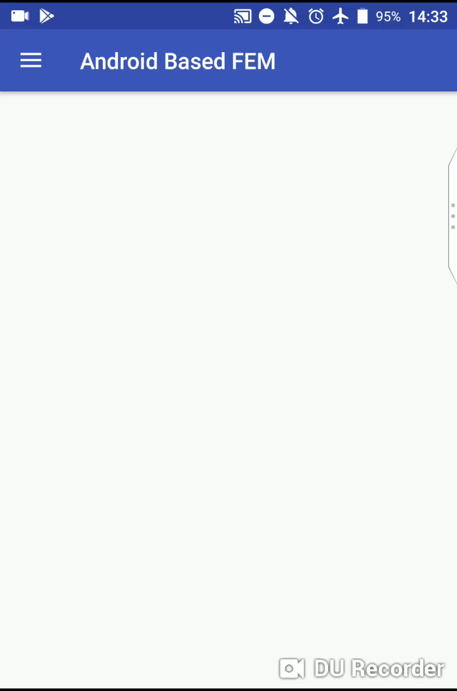
Android App Workflow
Java App
Json File Storage
FEM Package (C++)
Geometry
Material
Json
Mesher
Mesh
BC’s
Json
Solver
Results
Json

Slide 10
Work Plan
Done
Get familiar with the Android Development Environment
Construct Android application layout
Make rendering framework available
Implement the FEM-Package (C++)
Add some features to the application (Mostly About Visualization)
To - Do
Implement a Model Order Reduction method
First deploy chair’s existing code into developed FEM flow and make performance test
If time permits go experimental
Add further features to the application (e.g. geometry types, elements types… )

